Slide 1
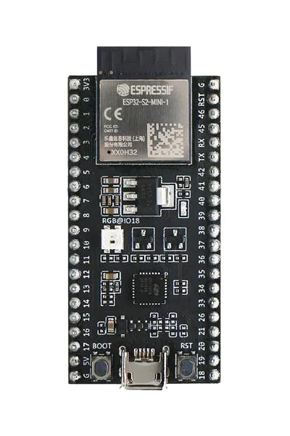
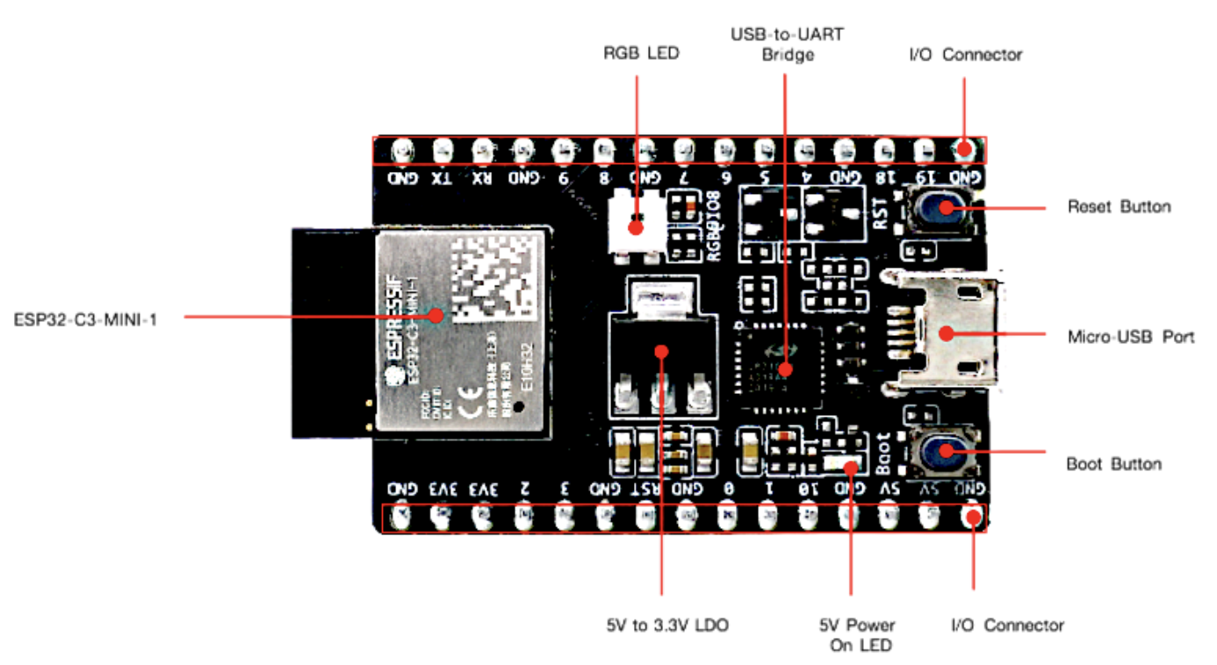
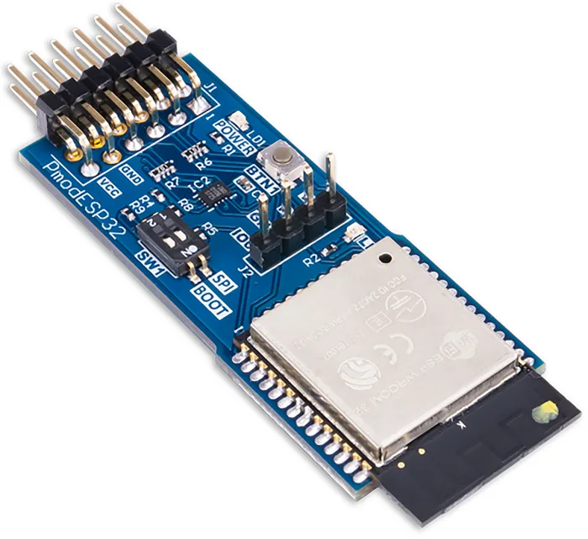
ESP32-S2 Wifi Microcontroller(2$-5$)
- single core - 32-bit RISC-V CPU core running at up to 240 MHz
ESP32-C3 Wifi Microcontroller(1$-3$)
- single core-32-bit RISC-V CPU core running at up to 160 MHz.
ESP32-WROOM Wifi and Bluetooth module(5$-10$)
dual-core

